Slide 1

Project
evaluation
----- HandWriting Recognition group 1

Slide 2
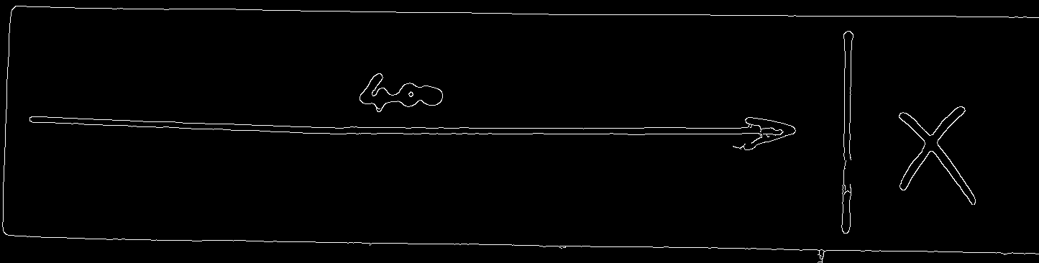

Evaluation metrics
Preprocessing
Detection of noise
Inputs symbols dimensions
Shapes, Test data set
Hough transformation
Symbol Recognition
HSV color space
Dimensions of symbols
Detected digits and symbols seem satisfiable as seen.

Slide 3
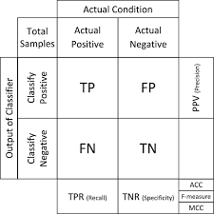
Digit Recognition
Digit Recognition procedures
Get data from Minst
Build the CNN model
Test the model based on test data of Minst
Test the model based on our own data (the photos we made)
So there will be two Confusion Matrices we can get. But we will pay more attention to the one we get based on our own pictures.

Slide 4
Proposed Project Evaluation Plan
Testing the Algorithm
Heuristic
Stability of interpretation
Precision of cut line
Level of Robustness
Detected Information
Accuracy
Work pieces
The overall project
The time management
Well defined goal
The good model
Well written report
Good Assigning individual works in team
Good cooperation and communication in team group.

Slide 5
The Good
The Bad
The Ugly
We may make the judgement of good, bad and ugly based on the TFR and TNR from metric.
the good model should be with high TFR and low TNR.
the bad model has median TFR and TNR. Or one of them are high but another is normal.
the ugly model has low TFR or high TNR.

